Slide 1
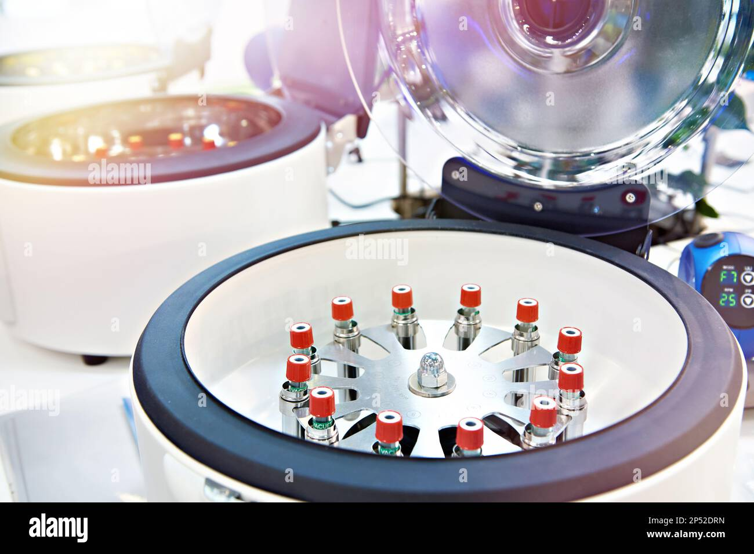
METHODS OF STUDYING CELLS
Subcellular fractionation

Slide 2

Lesson plan
1. Definition
2. Objectives of subcellular fractionation
3. Steps of subcellular fractionation
A- Homogenization (Cell disruption)
B- Centrifugation
a- Differential centrifugation
b- Density gradient centrifugation

Slide 3

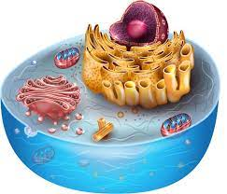
1- Definition
Subcellular fractionation is a technique to isolate organelles from cells, typically involving homogenization (cell disruption) followed by differential or gradient centrifugation.

Slide 4
2. Main objectives of subcellular fractionation technique
1
Study function and localization of cell molecules
2
Purify organelles for biochemical or for morphological studies (EM)
3
Understand disease mechanisms

Slide 5
3. Steps of subcellular fractionation
Homogenization (Cell disruption)
Purpose: To break the cell membrane and wall (if present) to release their internal components (homogenate).
1
Separation (Centrifugation): Purpose: To separate the organelles from the cell homogenate.
2

Slide 6
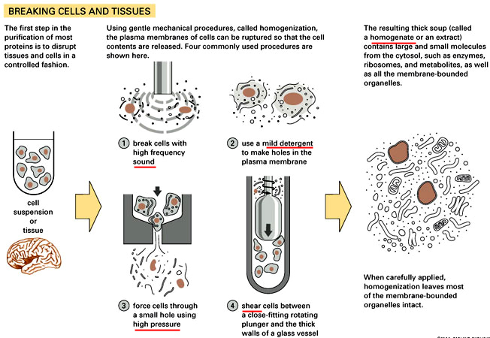
1. Homogenization (Cell disruption)
Homogenate

Slide 7
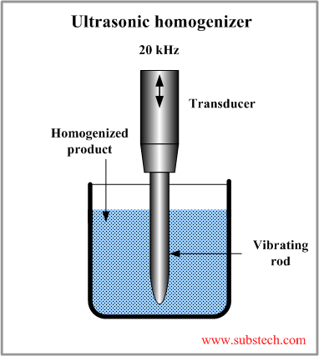
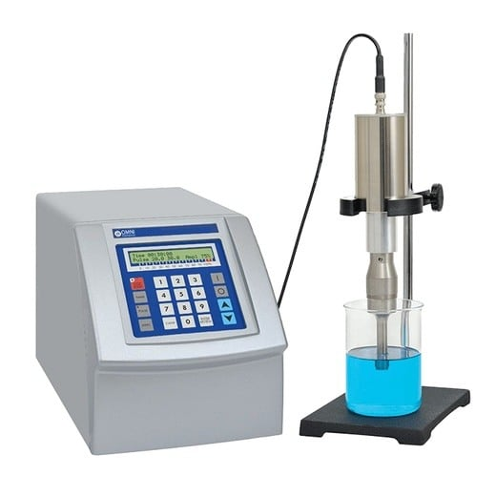
Ultrasonic homogenizer

Slide 8
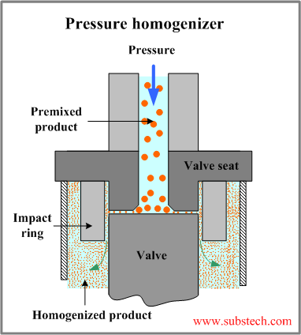
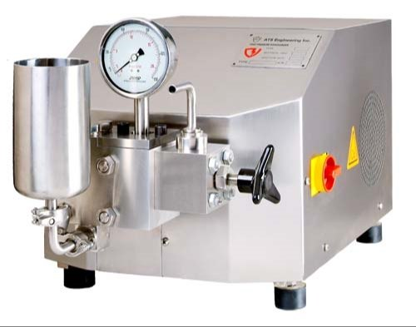
Pressure homogenizer

Slide 9
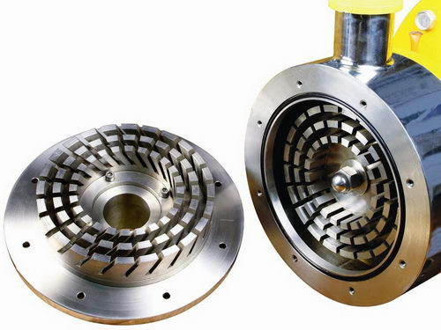
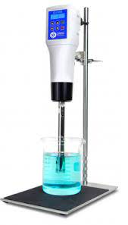
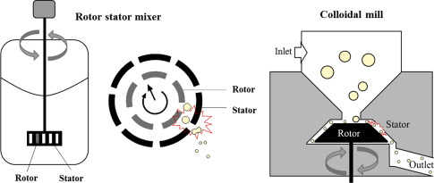
Rotor-Stator homogenizer

Slide 10
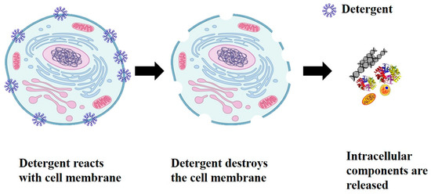
Chemical homogenization

Slide 11
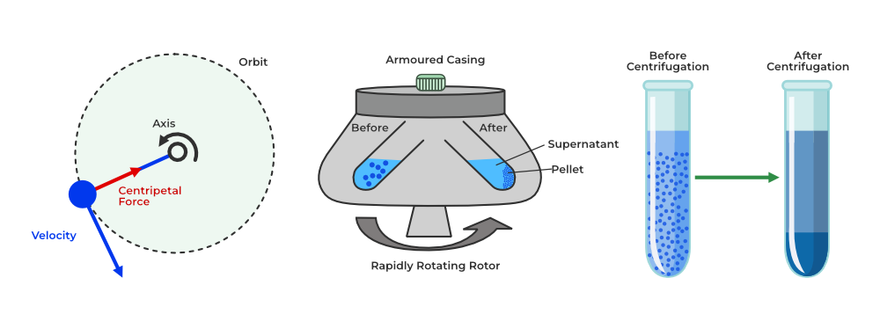
2- Separation (Centrifugation)
Separation and fractionation of cellular components
surnageant
culot

Slide 12
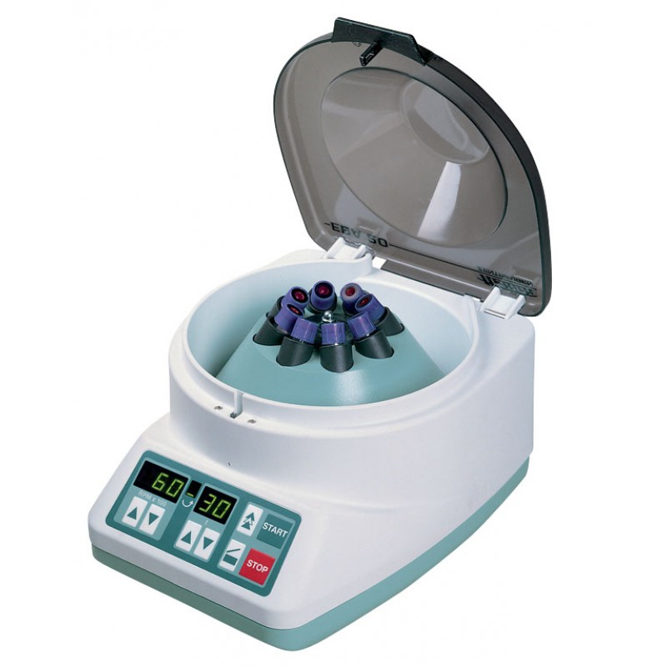
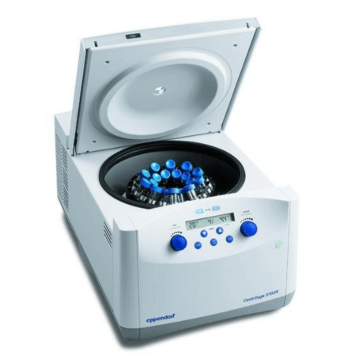
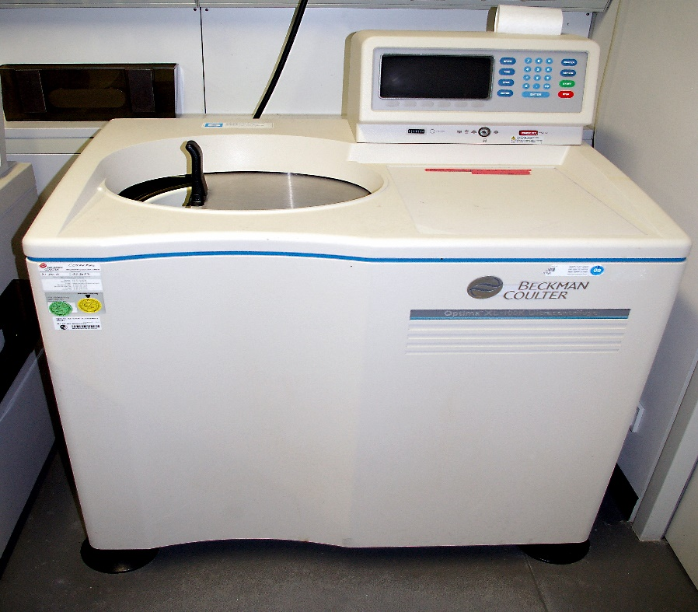
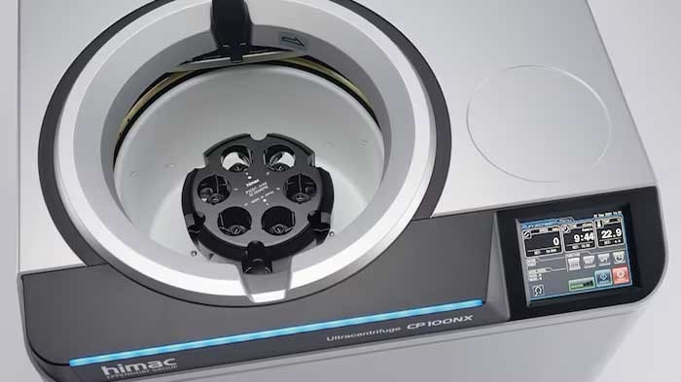
2. Separation (centrifugation)

Slide 13
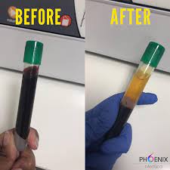
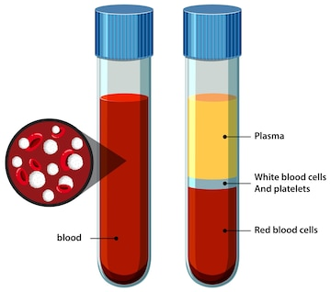
Example: In medical laboratory, hematology
Before
After
1000 to 2000 g for 10-15 min

Slide 14
3. Types of centrifugation (in cell biology)
Differential centrifugation
Density gradient centrifugation

Slide 15
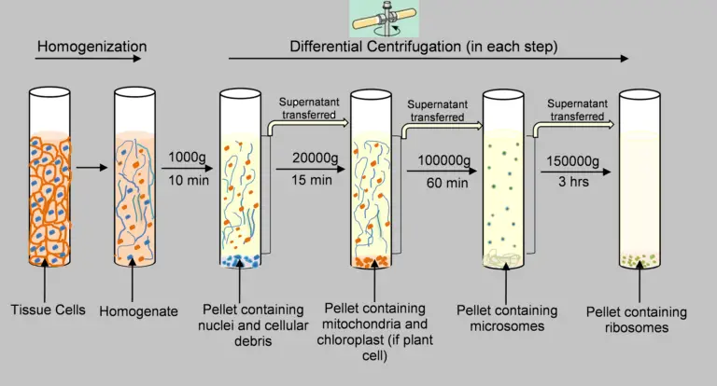
A. Differential centrifugation
Peroxysomes and lysosomes

Slide 16
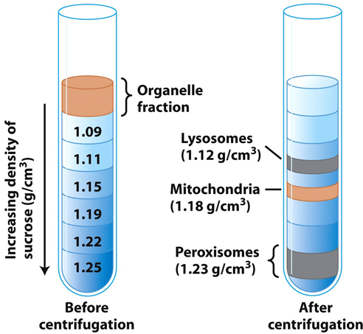
B. Density gradient centrifugation
B.1. Pre-formed (discontinuous) density gradient

Slide 17
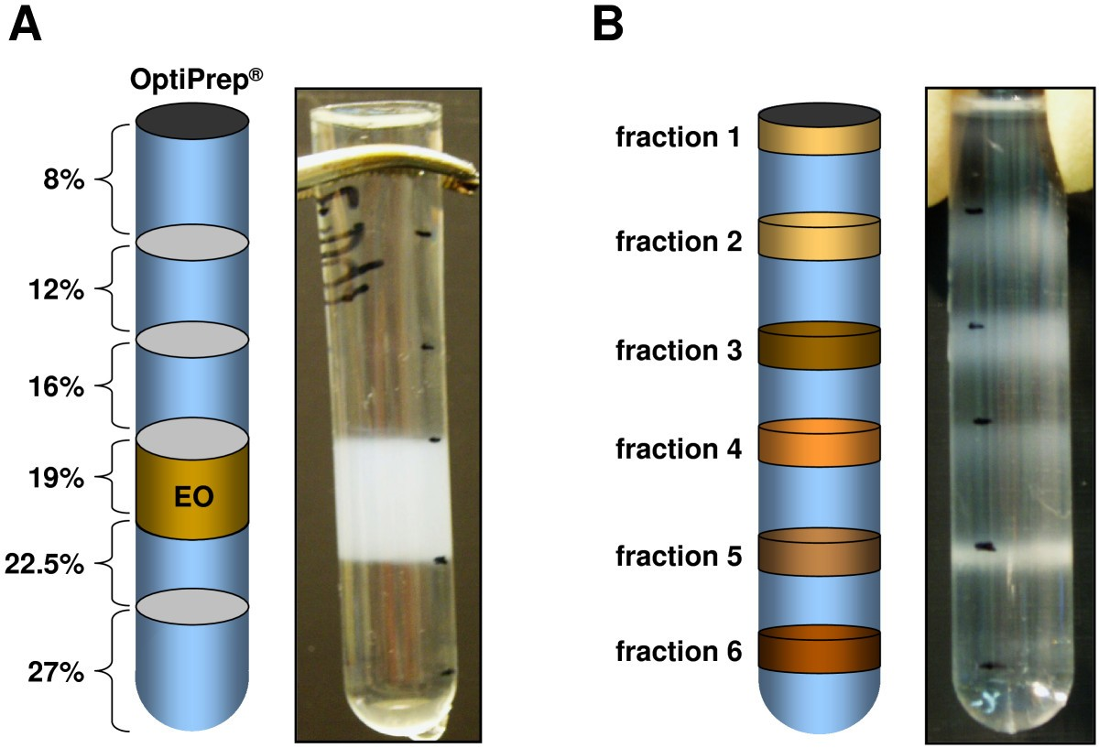

Slide 18
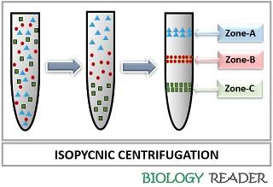
B.2. Self-formed (continuous) density gradient (CsCl)

Slide 19
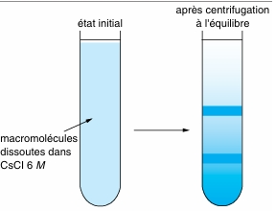

Slide 20
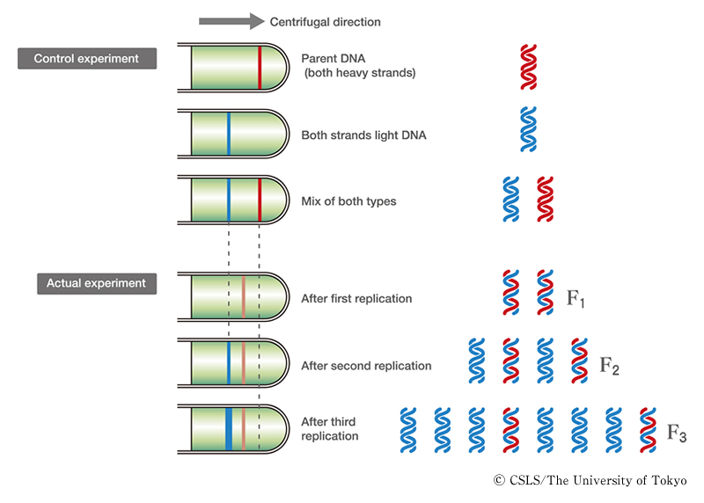
Self-formed density gradient CsCl (Meselson and Stahl experiment (1958))

